Slide 1
CHI SQUARE TEST

Slide 2
Parametric and Nonparametric Tests
This lecture introduces two non-parametric thypothesis tests using the chi-square statistic: the chi-square test for goodness of fit and the chi-square test for independence.

Slide 3
Parametric and Nonparametric Tests (cont.)
The term "non-parametric" refers to the fact that the chi‑square tests do not require assumptions about population parameters nor do they test hypotheses about population parameters.
Previous examples of hypothesis tests, such as the t tests and analysis of variance, are parametric tests and they do include assumptions about parameters and hypotheses about parameters.

Slide 4
Parametric and Nonparametric Tests (cont.)
The most obvious difference between the chi‑square tests and the other hypothesis tests we have considered (t and Z) is the nature of the data.
For chi‑square, the data are frequencies rather than numerical scores.

Slide 5
Nonparametric Statistics
A special class of hypothesis tests
Used when assumptions for parametric tests are not met
Review: What are the assumptions for parametric tests?

Slide 6
Assumptions for Parametric Tests
The dependent variable is a scale variable ➔ interval or ratio
If the dependent variable is ordinal or nominal, it is a non-parametric test
Participants are randomly selected
If there is no randomization, it is a non-parametric test
The underlying population distribution is normal
If the shape is not normal, it is a non-parametric test

Slide 7
Limitations of Nonparametric Tests
Cannot easily use confidence intervals or effect sizes
Have less statistical power than parametric tests
Nominal and ordinal data provide less information
More likely to commit type II error
Review: What is type I error? Type II error?

Slide 8
The Chi-Square Test for Goodness-of-Fit
The chi-square test for goodness-of-fit uses frequency data from a sample to test hypotheses about the shape or proportions of a population.
Each individual in the sample is classified into one category on the scale of measurement.
The data, called observed frequencies, simply count how many individuals from the sample are in each category.

Slide 9
The Chi-Square Test for Goodness-of-Fit (cont.)
The null hypothesis specifies the proportion of the population that should be in each category.
The proportions from the null hypothesis are used to compute expected frequencies that describe how the sample would appear if it were in perfect agreement with the null hypothesis.

Slide 10

Chi-Square test for goodness of fit- An Example
-Is the frequency of balls with different colors equal in our bag?
Observed Frequencies
50 | 30 | 30 | 10
Expected Frequencies
25% | 25% | 25% | 25%

Slide 11
Chi-Square test for goodness of fit
Observed Frequencies
Total
50 | 30 | 30 | 10
120
Expected Frequencies
25% | 25% | 25% | 25%
×
120
=
Expected Frequencies
H0
30 | 30 | 30 | 30

Slide 12
Chi-Square test for goodness of fit
Observed Frequencies
50 | 30 | 30 | 10
Expected Frequencies
30 | 30 | 30 | 30
Difference
Normalize

Slide 13
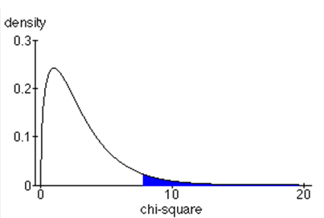
Chi-Square test for goodness of fit
Critical value = 7.81
26.6
χ²(3,n=120) = 26.66,
p< 0.001

Slide 14
Chi-Square test for Goodness of fit
Chi-Square test for goodness of fit is like one sample t-test
You can test your sample against any possible expected values
25% | 25% | 25% | 25%
H0
10% | 10% | 10% | 70%
H0

Slide 15
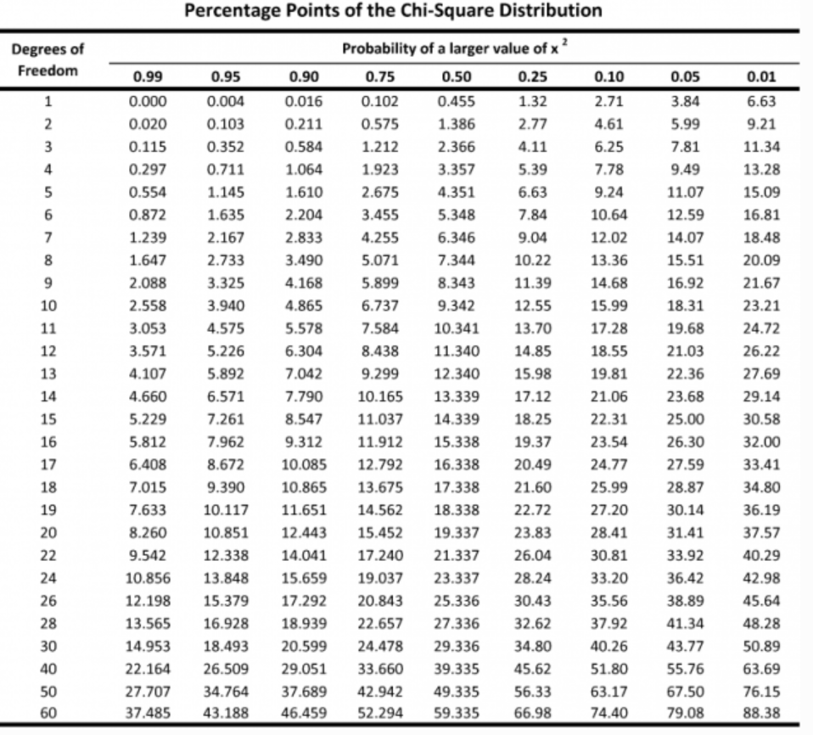

Slide 16
The Chi-Square Test for Independence
The second chi-square test, the chi-square test for independence, can be used and interpreted in two different ways:
1. Testing hypotheses about the relationship between two variables in a population, or
2. Testing hypotheses about differences between proportions for two or more populations.

Slide 17
The Chi-Square Test for Independence (cont.)
Although the two versions of the test for independence appear to be different, they are equivalent and they are interchangeable.
The first version of the test emphasizes the relationship between chi-square and a correlation, because both procedures examine the relationship between two variables.

Slide 18
The Chi-Square Test for Independence (cont.)
The second version of the test emphasizes the relationship between chi-square and an independent-measures t test (or ANOVA) because both tests use data from two (or more) samples to test hypotheses about the difference between two (or more) populations.

Slide 19
The Chi-Square Test for Independence (cont.)
The first version of the chi-square test for independence views the data as one sample in which each individual is classified on two different variables.
The data are usually presented in a matrix with the categories for one variable defining the rows and the categories of the second variable defining the columns.

Slide 20
The Chi-Square Test for Independence (cont.)
The data, called observed frequencies, simply show how many individuals from the sample are in each cell of the matrix.
The null hypothesis for this test states that there is no relationship between the two variables; that is, the two variables are independent.

Slide 21
The Chi-Square Test for Independence (cont.)
The second version of the test for independence views the data as two (or more) separate samples representing the different populations being compared.
The same variable is measured for each sample by classifying individual subjects into categories of the variable.
The data are presented in a matrix with the different samples defining the rows and the categories of the variable defining the columns..

Slide 22
The Chi-Square Test for Independence (cont.)
The data, again called observed frequencies, show how many individuals are in each cell of the matrix.
The null hypothesis for this test states that the proportions (the distribution across categories) are the same for all of the populations

Slide 23
The Chi-Square Test for Independence (cont.)
Both chi-square tests use the same statistic. The calculation of the chi-square statistic requires two steps:
1. The null hypothesis is used to construct an idealized sample distribution of expected frequencies that describes how the sample would look if the data were in perfect agreement with the null hypothesis.

Slide 24
The Chi-Square Test for Independence (cont.)
For the goodness of fit test, the expected frequency for each category is obtained by
expected frequency = f_{e} = p x n
(p is the proportion from the null hypothesis and n is the size of the sample)
For the test for independence, the expected frequency for each cell in the matrix is obtained by
(row total)x(column total)
expected frequency = f_{e} = ─────────────────
n

Slide 25
The Chi-Square Test for Independence (cont.)
2. A chi-square statistic is computed to measure the amount of discrepancy between the ideal sample (expected frequencies from H₀) and the actual sample data (the observed frequencies = f_{o}).
A large discrepancy results in a large value for chi-square and indicates that the data do not fit the null hypothesis and the hypothesis should be rejected.

Slide 26
Chi-Square test for independence- An Example
When we have two or more sets of categorical data (IV,DV both categorical)
F_{O}
None
Obama
McCain
Male
10 | 50 | 35
15 | 60 | 40
95
Female
115
25
110
75
210

Slide 27
Chi-Square test for independence- An Example
Also called contingency table analysis
H0: There is no relation between gender and voting preference (like correlation)
OR
H0: There is no difference between the voting preference of males and females (like t-test)
The logic is the same as the goodness of fit test: Comparing observed freq and Expected freq if the two variables were independent

Slide 28
Chi-Square test for independence- An Example
F_{O}
None
Obama
McCain
Male
10 | 50 | 35
15 | 60 | 40
95
Female
115
25
110
75
210
F_{E}
None
Obama
McCain
Male
Female
12%
52%
36%
100%

Slide 29
Chi-Square test for independence
In case of independence:
F_{E}
None
Obama
McCain
Male
12% | 52% | 36%
12% | 52% | 36%
×
95
Female
×
115
12%
52%
36%
100%
Finaly:
None
Obama
McCain
F_{E}
Male
11.4 | 49.4 | 34.2
13.8 | 59.8 | 41.4
Female

Slide 30
Chi-Square test for independence
Another way:
F_{E}
None
Obama
McCain
95 x 25 210
95
Male
Female
210
25

Slide 31
Chi-Square test for independence
Now we can calculate the chi square value :
F_{O}
10 | 50 | 35
15 | 60 | 40
F_{E}
11.4 | 49.4 | 34.2
13.8 | 59.8 | 41.4

Slide 32
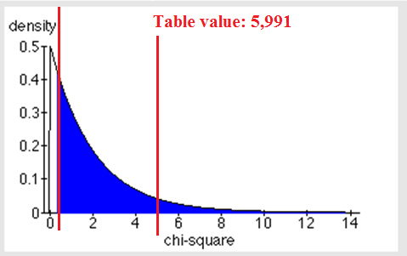
Chi-Square test for independence- An Example
χ²(2, n=210) = 0.35
There is no significant effect of gender on vote preference
Or
We cannot reject the null hypothesis that gender and vote preference are independent

Slide 33
Contingency Table Example
Left-Handed vs. Gender
Dominant Hand: Left vs. Right
Gender: Male vs. Female
2 categories for each variable, so this is called a 2 x 2 table
Suppose we examine a sample of
300 children

Slide 34
Contingency Table Example
(continued)
Sample results organized in a contingency table:
sample size = n = 300:
Gender | Hand Preference
 | Left | Right
Female | 12 | 108 | 120
Male | 24 | 156 | 180
 | 36 | 264 | 300
120 Females, 12 were left-handed
180 Males, 24 were left-handed

Slide 35
χ² Test for the Difference Between Two Proportions
H₀: π₁ = π₂ (Proportion of females who are left
handed is equal to the proportion of
males who are left-handed)
H₁: π₁ ≠ π₂ (The two proportions are not the same)
If H₀ is true, then the proportion of left-handed females should be the same as the proportion of left-handed males
The two proportions above should be the same as the proportion of left-handed people overall

Slide 36
The Chi-Square Test Statistic
The Chi-square test statistic is:
where:
f_{o} = observed frequency in a particular cell
f_{e} = expected frequency in a particular cell if H₀ is true
(Assumed: each cell in the contingency table has expected
frequency of at least 5)

Slide 37
Decision Rule
The test statistic approximately follows a chi-squared distribution with one degree of freedom
Decision Rule:
If , reject H₀, otherwise, do not reject H₀
α
0
χ²
Do not
reject H₀
Reject H₀
χ²_{α}

Slide 38
Observed vs. Expected Frequencies
Gender | Hand Preference
 | Left | Right
Female | Observed = 12 Expected = 14.4 | Observed = 108 Expected = 105.6 | 120
Male | Observed = 24 Expected = 21.6 | Observed = 156 Expected = 158.4 | 180
 | 36 | 264 | 300

Slide 39
The Chi-Square Test Statistic
Gender | Hand Preference
 | Left | Right
Female | Observed = 12 Expected = 14.4 | Observed = 108 Expected = 105.6 | 120
Male | Observed = 24 Expected = 21.6 | Observed = 156 Expected = 158.4 | 180
 | 36 | 264 | 300
The test statistic is:

Slide 40
Decision Rule
Decision Rule:
If > 3.841, reject H₀, otherwise, do not reject H₀
Here,
= 0.7576< = 3.841,
so we do not reject H₀ and conclude that there is not sufficient evidence that the two proportions are different at α = 0.05
0.05
0
χ²
Do not
reject H₀
Reject H₀
χ²_{0.05} = 3.841

Slide 41
χ² Test for Differences Among More Than Two Proportions
Extend the χ² test to the case with more than two independent populations:
H₀: π₁ = π₂ = … = π_{c}
H₁: Not all of the π_{j} are equal (j = 1, 2, …, c)

Slide 42
The Chi-Square Test Statistic
The Chi-square test statistic is:
Where:
f_{o} = observed frequency in a particular cell of the 2 x c table
f_{e} = expected frequency in a particular cell if H₀ is true
(Assumed: each cell in the contingency table has expected
frequency of at least 1)

Slide 43
χ² Test of Independence
Similar to the χ² test for equality of more than two proportions, but extends the concept to contingency tables with r rows and c columns
H₀: The two categorical variables are independent
(i.e., there is no relationship between them)
H₁: The two categorical variables are dependent
(i.e., there is a relationship between them)

Slide 44
χ² Test of Independence
(continued)
The Chi-square test statistic is:
where:
f_{o} = observed frequency in a particular cell of the r x c table
f_{e} = expected frequency in a particular cell if H₀ is true
(Assumed: each cell in the contingency table has expected
frequency of at least 1)

Slide 45
Expected Cell Frequencies
Expected cell frequencies:
Where:
row total = sum of all frequencies in the row
column total = sum of all frequencies in the column
n = overall sample size

Slide 46
Decision Rule
The decision rule is
If , reject H₀,
otherwise, do not reject H₀
2
Where χ_{α} is from the chi-square distribution with (r – 1) (c – 1) degrees of freedom

Slide 47
Example
The meal plan selected by 200 students is shown below:
Class Standing | Number of meals per week |  |  | Total
 | 20/week | 10/week | none
Fresh. | 24 | 32 | 14 | 70
Soph. | 22 | 26 | 12 | 60
Junior | 10 | 14 | 6 | 30
Senior | 14 | 16 | 10 | 40
Total | 70 | 88 | 42 | 200

Slide 48
Example
(continued)
The hypothesis to be tested is:
H₀: Meal plan and class standing are independent
(i.e., there is no relationship between them)
H₁: Meal plan and class standing are dependent
(i.e., there is a relationship between them)

Slide 49
Example: Expected Cell Frequencies
(continued)
Observed:
Class Standing | Number of meals per week |  |  | Total
 | 20/wk | 10/wk | none
Fresh. | 24 | 32 | 14 | 70
Soph. | 22 | 26 | 12 | 60
Junior | 10 | 14 | 6 | 30
Senior | 14 | 16 | 10 | 40
Total | 70 | 88 | 42 | 200
Expected cell frequencies if H₀ is true:
Class Standing | Number of meals per week |  |  | Total
 | 20/wk | 10/wk | none
Fresh. | 24.5 | 30.8 | 14.7 | 70
Soph. | 21.0 | 26.4 | 12.6 | 60
Junior | 10.5 | 13.2 | 6.3 | 30
Senior | 14.0 | 17.6 | 8.4 | 40
Total | 70 | 88 | 42 | 200
Example for one cell:

Slide 50
Example: The Test Statistic
(continued)
The test statistic value is:
2
χ_{0.05} = 12.592 from the chi-square distribution with (4 – 1)(3 – 1) = 6 degrees of freedom

Slide 51
Example: Decision and Interpretation
(continued)
Decision Rule:
If > 12.592, reject H₀, otherwise, do not reject H₀
0.05
Here,
= 0.709 < = 12.592,
so do not reject H₀
Conclusion: there is not sufficient evidence that meal plan and class standing are related at α = 0.05
0
χ²
Do not
reject H₀
Reject H₀
χ²_{0.05}=12.592

Slide 53

Award Preference & SAT
The data in StudentSurvey includes two categorical variables:
Award = Academy, Nobel, or Olympic
HigherSAT = Math or Verbal
Do you think there is a relationship between the award preference and which SAT is higher? If so, in what way?

Slide 54
Award Preference & SAT
HigherSAT | Academy | Nobel | Olympic | Total
Math | 21 | 68 | 116 | 205
Verbal | 10 | 79 | 61 | 150
Total | 31 | 147 | 177 | 355
Data are summarized with a 2×3 table for a sample of size n=355.
H₀ : Award preference is not associated with which SAT is higher
H_{a} : Award preference is associated with which SAT is higher
If H₀ is true ⟹ The award distribution is expected to be the same in each row.

Slide 55

Expected Counts
HigherSAT | Academy | Nobel | Olympic | Total
Math | 21 | 68 | 116 | 205
Verbal | 10 | 79 | 61 | 150
Total | 31 | 147 | 177 | 355
HigherSAT | Academy | Nobel | Olympic | Total
Math |  |  |  | 205
Verbal |  |  |  | 150
Total | 31 | 147 | 177 | 355
Note: The expected counts maintain row and column totals, but redistribute the counts as if there were no association.

Slide 56
Chi-Square Statistic
HigherSAT | Academy | Nobel | Olympic | Total
Math | 21 (17.9) | 68 (84.9) | 116 (102.2) | 205
Verbal | 10 (13.1) | 79 (62.1) | 61 ( 74.8) | 150
Total | 31 | 147 | 177 | 355
HigherSAT | Academy | Nobel | Olympic
Math
Verbal

Slide 57
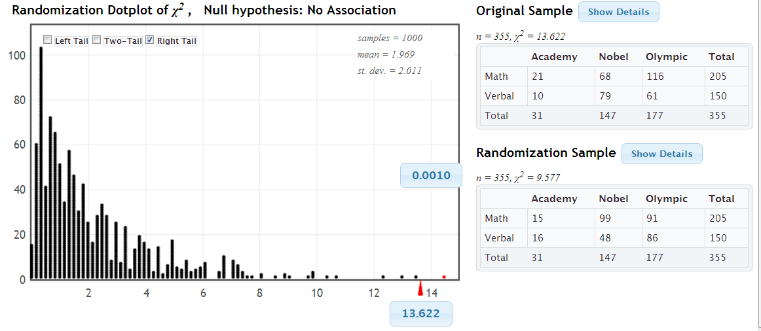
Randomization Test
www.lock5stat.com/statkey
p-value=0.001 ⟹ Reject H₀
We have evidence that award preference is associated with which SAT score is higher.

Slide 58
Chi-Square (χ²) Distribution
If each of the expected counts are at least 5, AND if the null hypothesis is true, then the χ² statistic follows a χ² –distribution, with degrees of freedom equal to
df = (number of rows – 1)(number of columns – 1)
Award by HigherSAT:
df = (2 – 1)(3 – 1) = 2

Slide 59
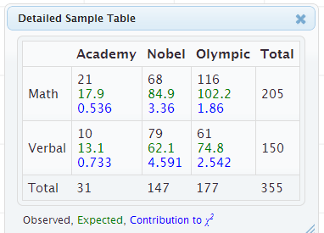
Chi-Square Test for Association
Note: The χ²-test for two categorical variables only indicates if the variables are associated. Look at the contribution in each cell for the possible nature of the relationship.

Slide 60
Chi-Square Test for Association
H₀ : The two variables are not associated
H_{a} : The two variables are associated
Calculate the expected counts for each cell:
Calculate the χ² statistic:
Compute the p-value as the area in the tail above the χ² statistic using either a randomization distribution, or a χ² distribution with df = (r – 1) (c – 1) if all expected counts > 5
Interpret the p-value in context.

